Slide 1
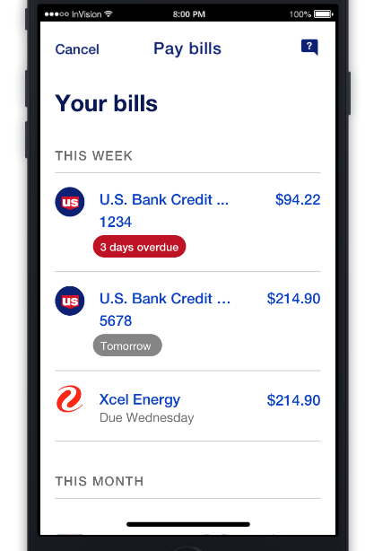
[MOB2-1576] Bill Pay - App | Select Biller Dashboard V1- UI Only

Slide 2
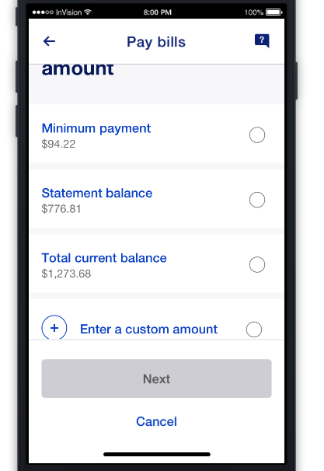
[MOB2-1578] Bill Pay - App | Consumer CCD (One-Time Payment): Choose amount [UI]

Slide 3
[MOB2-19678] Bill Pay - App | Consumer CCD (Autopay): Bill Payment Confirmation [UI]
Auto Pay - TO BE CONFIRMED

Slide 4
[MOB2-19691] Bill Pay - App | Consumer CCD (Autopay): Bill Payment Details [UI]
Auto Pay - TO BE CONFIRMED

Slide 5
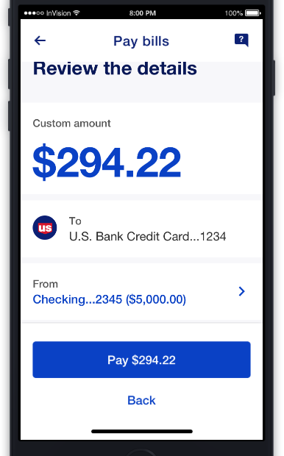
[MOB2-21046] Bill Pay - App | Consumer CCD (One-Time Payment): Add Payment Details [UI]

Slide 6
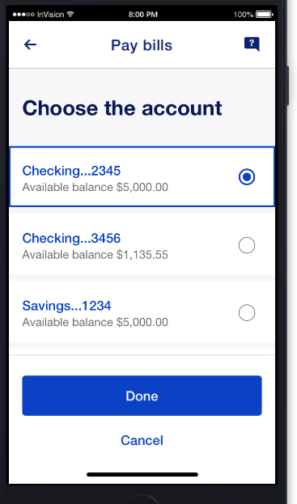
[MOB2-21048] Bill Pay - App | Consumer CCD (One-Time Payment): Choose "Pay From" Account [UI]

Slide 7
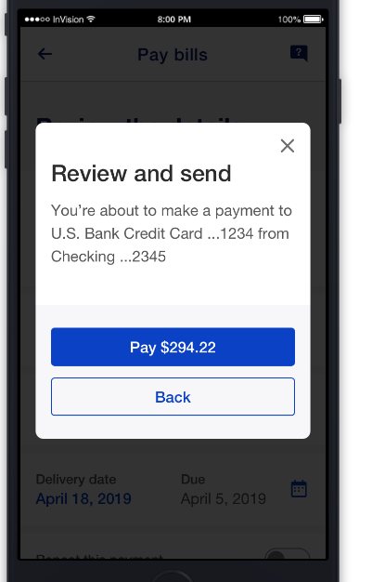
[MOB2-21696] Bill Pay - App | Consumer CCD (One-Time Payment): Review & Submit [UI]

Slide 8
[MOB2-21708] Bill Pay - App | Consumer CCD (Autopay): Review & Submit [UI]
Auto Pay - TO BE CONFIRMED

Slide 9
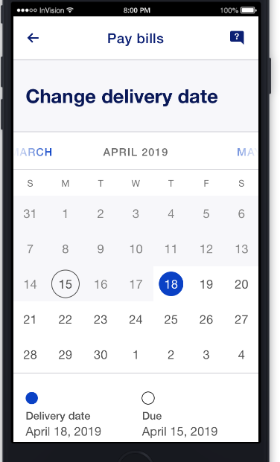
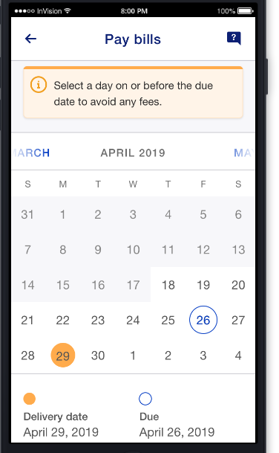
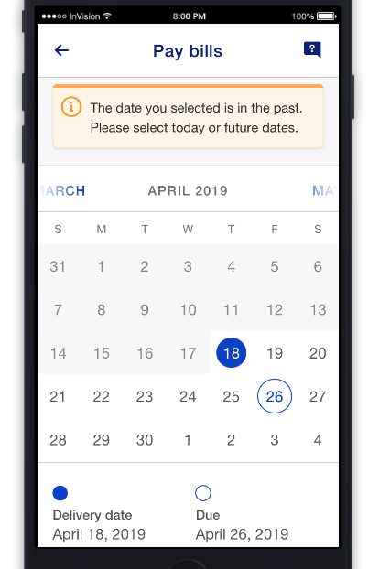
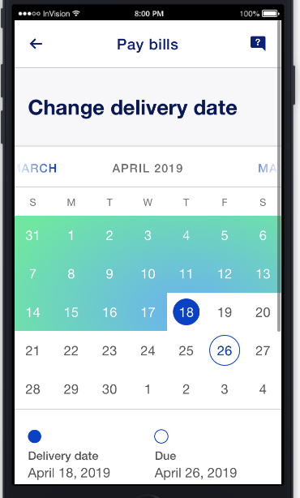
[MOB2-21724] Bill Pay - App | Consumer CCD (One-Time Payment): Select 'Pay On' Date [UI]

Slide 10
[MOB2-21766] Bill Pay - App | Consumer CCD (Autopay): Select Autopay Model [UI]
Auto Pay - TO BE CONFIRMED

Slide 11
[MOB2-21767] Bill Pay - App | Consumer CCD (Autopay): Select Stop Payment [UI]
Auto Pay - TO BE CONFIRMED

Slide 12
[MOB2-22216] Bill Pay - App | Select Biller Dashboard V1 Kill Switch
To Be Done

Slide 13
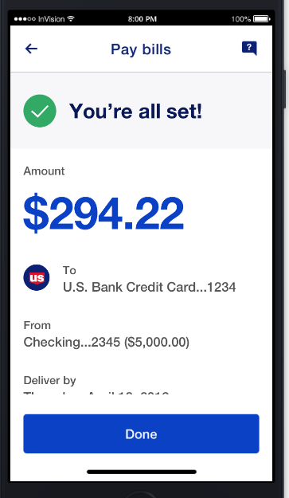
[MOB2-22268] Bill Pay - App | CCD - Consumer Credit Card (One-Time Payment): Confirmation [UI]

